Slide 1
SQL Saturday Dallas
May 19 2018

Slide 2
Get insights from data with Cognitive Services
Shawn Weisfeld
Cloud Solution Architect
Microsoft

Slide 3

About Me
Shawn Weisfeld
Cloud Solution Architect
Microsoft – One Commercial Partner Technical Team
sweisfel@microsoft.com
Austin, TX

Slide 4
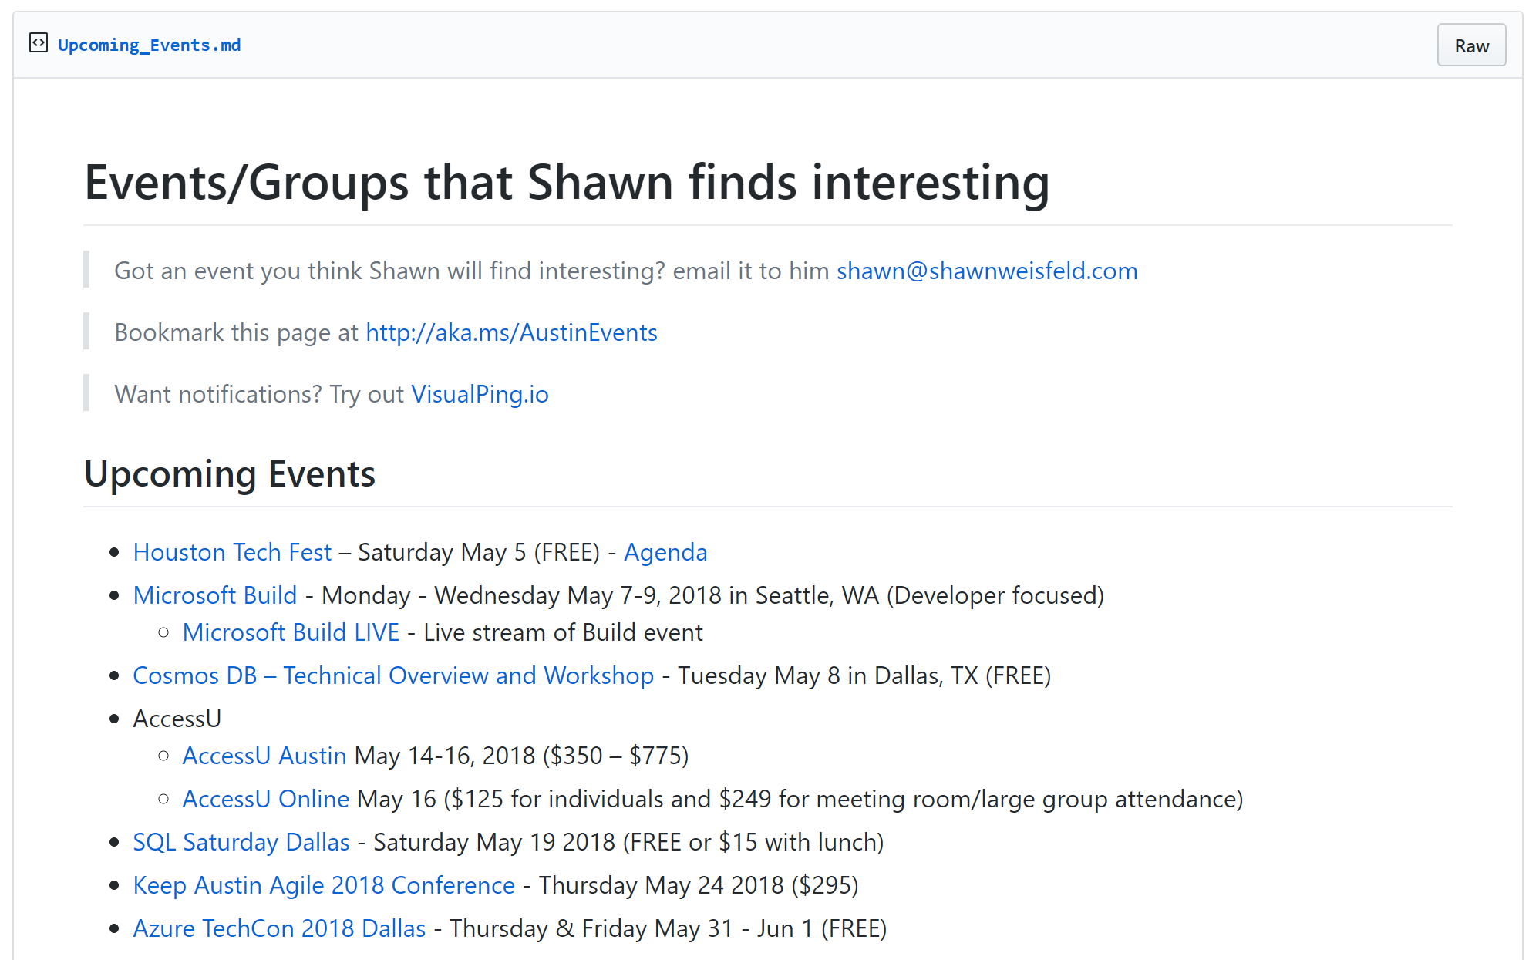

Regional Events
https://aka.ms/AustinEvents

Slide 5


Watch User Group presentations for FREE online! We now have over 775 presentations online
Miss a User Group meeting?
Forget something that you learned?
Want to see content from a User Group not in your area?
Want to share with a buddy?
Presentations from the thought leaders on the topics you care about including:
Agile
Azure
C#
Entity Framework
HTML5
MVC
SQL
jQuery
and Much More!
We know you cannot make it to every session,
that is why we post them online for you!
New Content added all the time!
For new content announcements
@UserGroupTV
http://www.UserGroup.tv

Slide 6

Austin TEALS Happy Hour – May 29
https://tealsaustincapital.eventbrite.com/

Slide 7
Agenda
Why Cognitive Services?
What Services are Available?
How do I use them?

Slide 8
Why Cognitive Services?

Slide 9
Video: Helpicto & Uber

Slide 10

T H E JFK F I L E S
The truth is in there

Slide 11


Slide 12

messy room picture here

Slide 13



How do we do this?
Ingest
Enrich
Explore

Slide 14


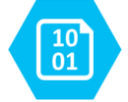

Ingest
Enrich
Explore
Cognitive skills
Data Feed
Search
Annotations
Cognitive Search Pattern

Slide 15

John F. Kennedy (JFK)
November 22, 1963
http://aka.ms/jfkfiles

Slide 16



Analyzing legal contracts
Understanding engineering plans
Extracting form information

Slide 17
What Services are Available?

Slide 18
Cognitive Services Directory
https://azure.microsoft.com/en-us/services/cognitive-services/directory/

Slide 19
How do I use them?

Slide 20
Demos
https://vi.microsoft.com
https://ww.getpostman.com

Slide 21
Build Announcements
Download custom vision models in TensorFlow, CoreML, and ONNX.
Unified Speech Service
Text to speech, Speech to text, speech translation
And Much Much More!
https://azure.microsoft.com/en-us/blog/microsoft-empowers-developers-with-new-and-updated-cognitive-services/

Slide 22

Thank you! Your Feedback is Important
Rate My Talk & Download Slides!
http://bit.ly/RateShawnsTalk
(case sensitive)
Contact Information
Email: sweisfel@microsoft.com
Blog: http://www.shawnweisfeld.com
Twitter: @shawnweisfeld

